Slide 1
Agenda
Digital citizenship and how to apply it to the classroom
RUP and the Academic Honesty Policy and sign/turn in

Slide 2
Do these look familiar?
Strives for quality work/ shows positive attitude toward learning
Follows directions
Works independently, completes work, stays on task
Organizes self, materials, and belongings
Participates appropriately in group activities
Respects adults, peers, school property
Takes risks to attempt new tasks
Listens attentively without interrupting
Makes appropriate transitions between activities

Slide 3
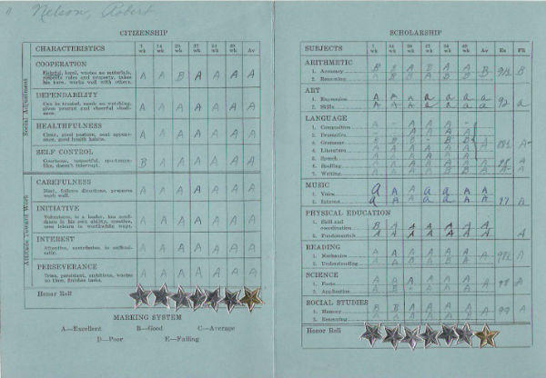

Slide 4
Definition
Digital citizenship can be defined as the norms of appropriate, responsible behavior with regard to technology use. NDP has specific rules governing online behavior covered in the Responsible Use Policy and the Academic Honesty Policy.

Slide 5
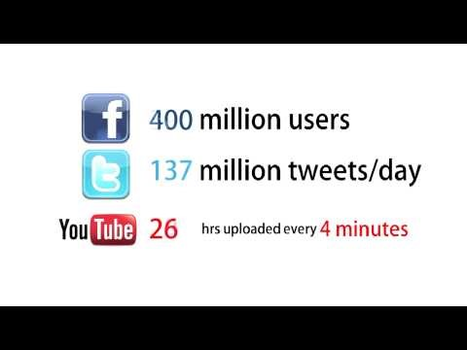

Slide 6
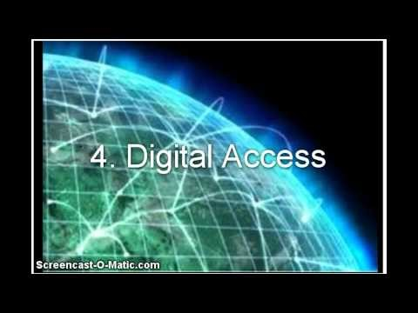

Slide 7
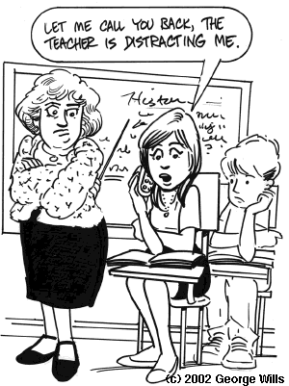

Slide 8
Brainstorm
What are the advantages of technology in the classroom? Disadvantages?

Slide 10
Consider…
Being aware of what you are doing online and how it may impact others as well as yourself.
Be reflective when you post online. What you post can be copied and pasted, taken out of context, misattributed, or altered. It is very difficult to get rid of an embarrassing or malicious post, photo, video, tweet, text or email. Just because you delete it does not mean it is gone!
Half (49%) of youth have regretted something they have posted online.

Slide 11
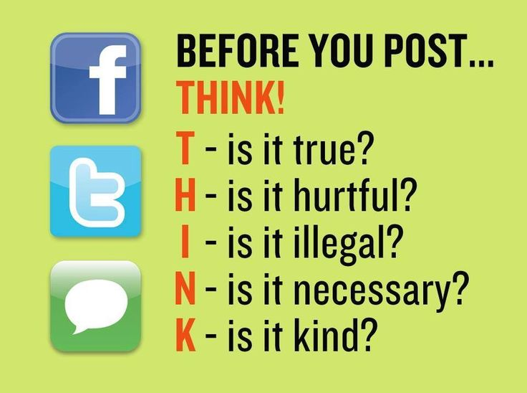

Slide 12
9 elements of digital citizenship
Etiquette: electronic standards of conduct or procedures
Access: full electronic participation in society
Law: electronic responsibility for actions and deeds
Communication: electronic exchange of information
- Literacy: process of teaching and learning about technology and the use of technology
- Commerce: electronic buying and selling of goods-Rights and Responsibilities: those freedoms extended to everyone in a digital world
- Safety (Security): electronic precautions to guarantee safety
- Health and Welfare: physical and psychological well-being in a digital technology world
Ribble, Mike. “Nine elements of digital citizenship.” www.digitalcitizenship.net. 2014. Web. 29 July 2014.

Slide 13
Choices…
Trend Micro’s 2011 Teen Responsible Internet Use Video Contest Grand Prize Winner: Where Are You?

Slide 15
Responsible Use Policy

Slide 16
Academic Honesty Policy

Slide 17
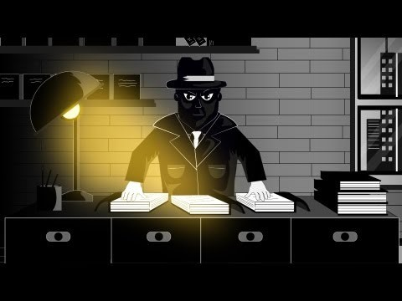
DPI video

Slide 18
Turnitin.com
Use your school email address ONLY.
If you’ve already created an account, please do not create another one.
Your classroom teachers will give you the join code for their class when school starts.

